Slide 1
Estimating the dose-toxicity curve from completed Phase I studies
Alexia Iasonos,
Irina Ostrovnaya
Department of Biostatistics
Memorial Sloan Kettering Cancer Center
CRM Workshop, October 2009

Slide 2
Motivation
Retrospective analysis of completed Phase I studies in order to recommend, possibly, a new MTD
    among existing/visited dose levels,
    between dose levels

Slide 3
Example
When tested levels are too low (safe), ie no activity
Example for Extrapolation:
Example for Interpolation
Dose level | 30 mg/m2 | 60 mg/m2 | 120 mg/m2 | 200 mg/m2
DLT/ # patients | 0/3 | 0/3 | 1/6 | 1/6
Dose level | 30 mg/m2 | 60 mg/m2 | 120 mg/m2 | 240 mg/m2
DLT/ # patients | 0/3 | 0/3 | 1/6 | 3/3 or 2/2

Slide 4
Motivation Cont.
2. Switching from 3+3 to adaptive design, how can we use toxicity data up to this point to add additional levels?

Slide 5
Statistical Question of Interest
If we can fit a curve to the existing trial/data then this curve can be used to interpolate or possibly extrapolate.
Dose-toxicity curve?

Slide 6
Available statistical methods for estimating the dose-response curve
Parametric:
probit or logit (Prentice 1976; He, 2006) sigmoid (Schmoyer 1984)
Non-parametric: isotonic regression (Stylianou, 2003)
Semi-parametric: splines or kernels (Kong 2006; Staniswalis 1988)
PROBLEM:
small sample size, 0 tox. at many dose levels;
model assumptions; change point from concave to convex

Slide 7
Literature Review
Can we use the Continual Reassessment Method (CRM) retrospectively?
CRM uses toxicity data accumulated on all pts and updates a model that assigns the next patient to a dose that is closest to the target toxicity rate

Slide 8
CRM and
retrospective CRM (retro-CRM)
are not the same.
Design (CRM)
vs
Analysis (retro-CRM)

Slide 9
Can we use CRM retrospectively?
O’ Quigley (2005) NO
You had already followed another design so you can’t analyze the data assuming they were collected under the CRM scheme.
Solution: if you weight the information obtained from toxicities at each dose, then you can use the retro-CRM methodology that accounts for the fact that CRM would have allocated pts/doses differently.

Slide 10

The weights are obtained by simulations and correspond to the percentage of patients CRM would have assigned to dose i .
A large number of CRM trials of size are simulated using as the true toxicity rates, where are the observed toxicity rates from the existing trial.
Weights depend on which CRM you use (cohorts or not)

Slide 11
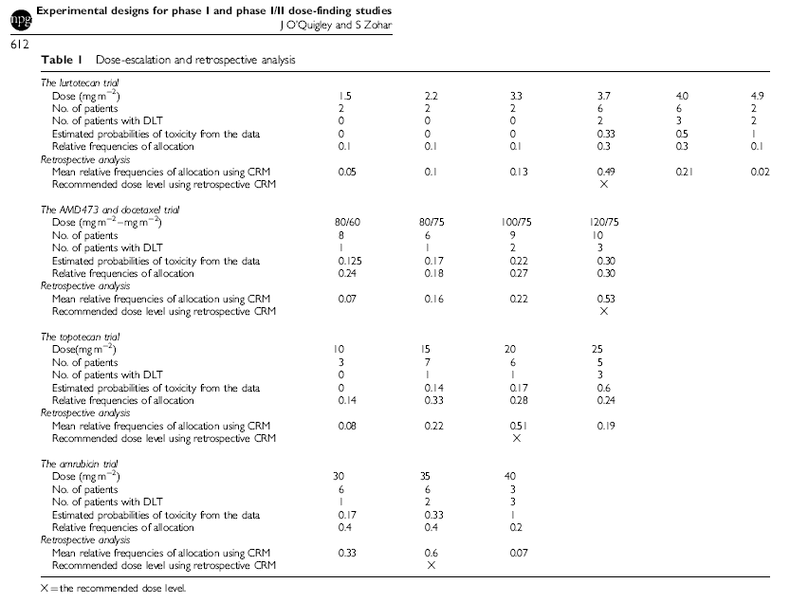

Slide 12
Message:
The trials followed a modified 3+3 design; MTD not based on the 3+3 algorithm
The two methods result in the same MTD but different patient/doses allocation ratio

Slide 13
Objective
To estimate the dose-toxicity curve based on available data from a completed trial
To evaluate the proposed method in 3+3 simulated trials, and compare it to retro-CRM

Slide 14
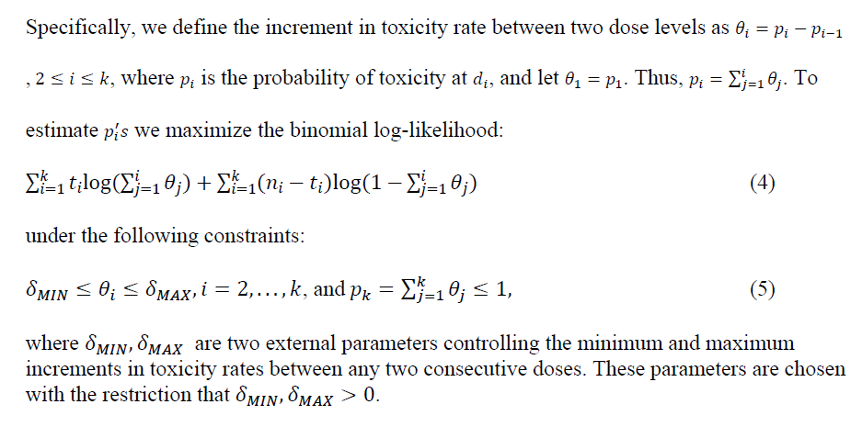
Constrained Maximum Likelihood Estimation (CMLE)
There is no restriction on the toxicity rate at the first dose, p₁.

Slide 15
Constrained Maximum Likelihood
CMLE
Use available data based on numerator and denominator separately , ie:
2/2, 3/3, or 6/6 has different implications
We will have constraints as of how much can this curve increase between adjacent dose levels:
  MIN= it has to increase by at least MIN value (useful at doses where we obtain no DLTs)
  MAX= it cannot increase by more than MAX value (this downplays the 100% observed at last dose - often out of 1-2 pts , e.g. 1/1 or 2/2)

Slide 16
Challenge: how to select MIN, MAX ?
5 levels, MIN=target rate at MTD/5=0.25/5=0.05
MAX=1/4=0.25

Slide 17
Constrained MLE
Small values of MIN_value lead to a conservative estimation by favoring a flatter curve, while larger values of MIN impose larger jumps when the existing dose levels are low.
Similarly, MAX_value controls toxic dose levels by constraining the curve from increasing radically when high toxicity rates are observed.
The curve is between these bounds but the shape is not restricted by a model; only the observed toxicities at each dose, i.e. both the numerator and denominator count for the structure of the curve.
Robust to the choice of MIN, MAX
    Fewer toxicities or pts then constrains matter
    Otherwise if available data are rich, constraints matter less

Slide 18
Simulations
Simulated 1000 trials followed 3+3 design, testing 6, 5, 4 dose levels, target tox. rate=0.25
Compared MTD by:
Standard Method (SM)
CRM- not weighted (LCRM – O’ Quigley, Shen 1996)
Retrospective CRM (CRM-w; O’ Quigley 2005)
CMLE (with various MIN/MAX)
Notes:
As described by Korn
As in CRM MLE based on paper
As in O’Quigley 2006 retro crm paper

Slide 19
Level | 0 | 1 | 2 | 3 | 4 | 5 | 6
True |  | .01 | .05 | .1 | .15 | .2 | .25
SM | <1 | 3 | 10 | 17 | 22 | 21 | 26
CRM |  | <1 | 3 | 14 | 27 | 31 | 22
CRM_w |  | 1 | 2 | 14 | 28 | 29 | 22
New |  | <1 | 3 | 14 | 27 | 30 | 26

Slide 20
Level | 0 | 1 | 2 | 3 | 4 | 5 | 6
True |  | .05 | .1 | .25 | .35 | .55 | .7
SM | 3 | 9 | 41 | 30 | 15 | 3
CRM | <1 | 4 | 22 | 45 | 25 | 4
CRM_w | 1 | 5 | 21 | 44 | 27 | 3
New | <1 | 4 | 23 | 45 | 25 | 4

Slide 21
 | 0 | 1 | 2 | 3 | 4 | 5 | NF
True |  | 0.05 | 0.10 | 0.15 | 0.20 | 0.30
SM | 3 | 9 | 21 | 21 | 24 | 22
CRM | <1 | 4 | 13 | 25 | 34 | 21 | 3
CRM_w | 1 | 5 | 11 | 25 | 33 | 22 | 3
New | <1 | 4 | 13 | 24 | 35 | 25

Slide 22
 | 0 | 1 | 2 | 3 | 4 | 5 | NF
True |  | .15 | .25 | .3 | .4 | .5
SM | 15 | 34 | 25 | 14 | 6 | 1 | 6
CRM | 9 | 22 | 36 | 24 | 8 | 1
CRM_w | 11 | 24 | 32 | 23 | 9 | 1 | <1
New | 14 | 23 | 30 | 23 | 9 | 1

Slide 23
 | 0 | 1 | 2 | 3 | 4 | NF
True |  | 0.15 | .25 | .3 | .4
SM | 15 | 34 | 26 | 14 | 6 | 6
CRM | 9 | 22 | 36 | 23 | 10 | <1
CRM_w | 10 | 24 | 32 | 23 | 10 | <1
New | 9 | 20 | 37 | 27 | 7

Slide 24
Additional Simulations (not shown)
Under true toxicity rates that violate the constraints in increments between adjacent dose levels
Under modified 3+3 trials that expanded accrual at MTD. If ≤ 3 toxicities were observed out of 10, then the MTD remained the same. Otherwise, the method de-escalated and followed the 3+3 scheme by expanding a cohort to 6 patients until ≥ 2 DLTs out of 6 patients were observed.

Slide 25
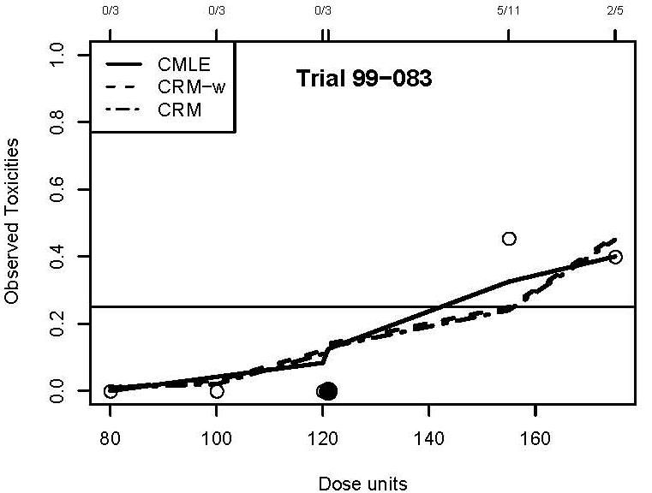
99-083: pralatrexate in combination with paclitaxel or docetaxel in adv solid tumors, doses 80P+35D,100/35,120/35 (2,16),120/35 (1,15), 120/35 (1,8,15), 140/35 ,
MTD dose 4= 120 (1,15) other methods suggest dose 5, one level above MTD of the trial

Slide 26
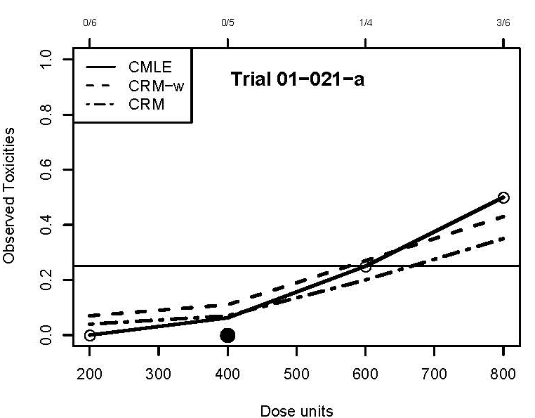
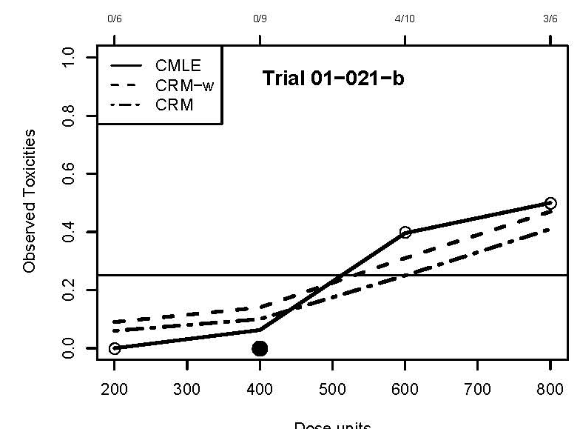
01-021 Phase I study of an oral histone deacetylase inhibitor, suberoylanilide hydroxamic acid, in patients with advanced cancer.
Oral SAHA, 200, 400, 600 mg qd or 400 mg bid after amend 200, 300 mg bid for solid tumors; Methods suggest 600, trial suggests 400

Slide 27
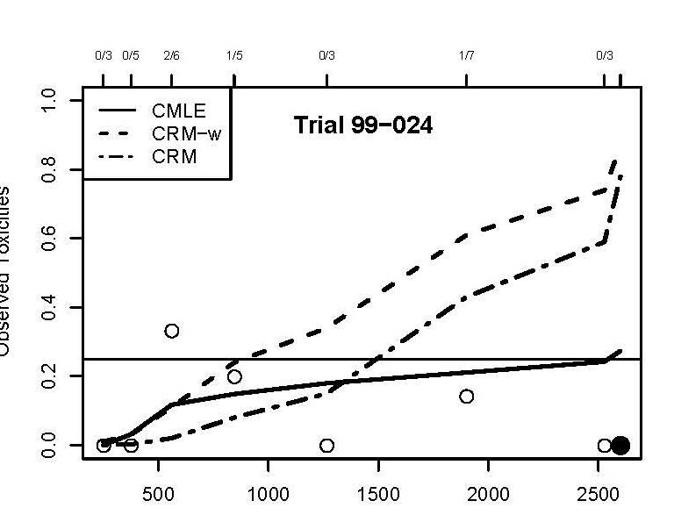
Phase I trial of the cyclin-dependent kinase inhibitor and protein kinase C inhibitor 7-hydroxystaurosporine in combination with Fluorouracil in patients with advanced solid tumors.
Trial recommended 2600 which is the last dose
CMLE recommends dose=7, retro-CRM recommends 4th level, not weighted CRM recommends 5th level

Slide 28
Confidence Intervals Estimation
Wilson CI (Agresti, 1998): upper confidence limit u_{i} for probability of toxicity p_{i}

Slide 30
Average Width of 95% CI across dose levels
All 95% CIs are conservative and have 99-100% coverage (across all dose levels) for all scenarios.

Slide 31
Confidence Intervals
Notes:
Use of Confidence Intervals
Use the actual units in dose spacing in estimating this curve
CI
at
dose 1 (0,0.32)
Dose 2 (0,0.42)
dose 3 (0.09,0.66)
dose 4 (0.17,0.81)

Slide 32
Dose spacing – use of actual units

Slide 33
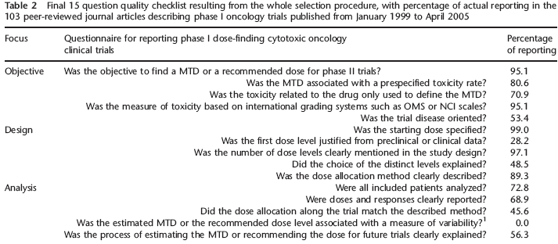
Quality assessment of Phase I dose-finding cancer trials – checklist (Zohar, Clinical Trials 2008)

Slide 34
Conclusion
Rogatko (JCO 2007) : phase I rarely follow the 3+3. They follow a 3+3 scheme with “deviations”
Since you deviate from the 3+3 you can’t assume that the statistical properties of 3+3 hold anymore.
Not efficient use of data even if they followed 3+3
The proposed analysis method can estimate a retrospective MTD by analyzing the data that you obtained from this deviated scheme/design.

Slide 35
Acknowledgements
Thank you to:
Elyn Riedel – data collection
Dr. Spriggs and other PIs of studies

